Slide 1
Manipulating Data
Notes:
Schedule: Timing Topic
60 minutes Lecture
30 minutes Practice
90 minutes Total

Slide 2
Objectives
After completing this lesson, you should be able to
do the following:
Describe each DML statement
Insert rows into a table
Update rows in a table
Delete rows from a table
Merge rows in a table
Control transactions
Notes:
Lesson Aim
In this lesson, you learn how to insert rows into a table, update existing rows in a table, and delete existing rows from a table. You also learn how to control transactions with the COMMIT, SAVEPOINT, and ROLLBACK statements.

Slide 3
Data Manipulation Language
A DML statement is executed when you:
  Add new rows to a table
  Modify existing rows in a table
  Remove existing rows from a table
A transaction consists of a collection of DML statements that form a logical unit of work.
Notes:
Data Manipulation Language
Data manipulation language (DML) is a core part of SQL. When you want to add, update, or delete data in the database, you execute a DML statement. A collection of DML statements that form a logical unit of work is called a transaction.
Consider a banking database. When a bank customer transfers money from a savings account to a checking account, the transaction might consist of three separate operations: decrease the savings account, increase the checking account, and record the transaction in the transaction journal. The Oracle server must guarantee that all three SQL statements are performed to maintain the accounts in proper balance. When something prevents one of the statements in the transaction from executing, the other statements of the transaction must be undone.
Instructor Note
DML statements can be issued directly in iSQL*Plus, performed automatically by tools such as Oracle Forms Services, or programmed with tools such as the 3GL precompilers.
Every table has INSERT, UPDATE, and DELETE privileges associated with it. These privileges are automatically granted to the creator of the table, but in general they must be explicitly granted to other users.
Starting with Oracle 7.2, you can place a subquery in the place of the table name in an UPDATE statement, essentially the same way you use a view.

Slide 4
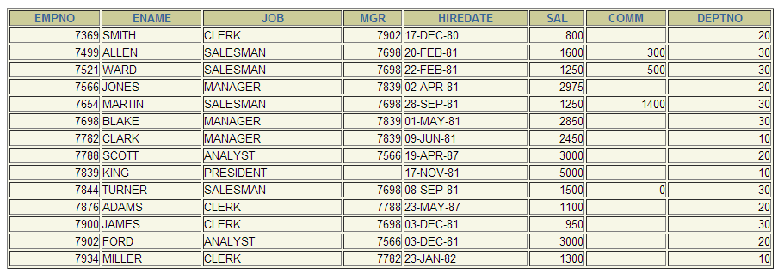
Adding a New Row to a Table
EMPLOYEE
Notes:
Adding a New Row to a Table
The slide graphic illustrates adding a new department to the DEPARTMENTS table.

Slide 5
The INSERT Statement Syntax
Add new rows to a table by using the INSERT statement.
Only one row is inserted at a time with this syntax.
INSERT INTO table [(column [, column...])]
VALUES (value [, value...]);
Notes:
Adding a New Row to a Table (continued)
You can add new rows to a table by issuing the INSERT statement.
In the syntax:
table is the name of the table
column is the name of the column in the table to populate
value is the corresponding value for the column
Note: This statement with the VALUES clause adds only one row at a time to a table.

Slide 6
Inserting New Rows
Insert a new row containing values for each column.
List values in the default order of the columns in the table.
Optionally, list the columns in the INSERT clause.
Enclose character and date values within single quotation marks.
INSERT INTO maxim(empno, ename,
job, deptno)
VALUES (1412, 'MACMILD', 'OIC', 10);
1 row created.
Notes:
Adding a New Row to a Table (continued)
Because you can insert a new row that contains values for each column, the column list is not required in the INSERT clause. However, if you do not use the column list, the values must be listed according to the default order of the columns in the table, and a value must be provided for each column.
DESCRIBE departments
For clarity, use the column list in the INSERT clause.
Enclose character and date values within single quotation marks; it is not recommended to enclose numeric values within single quotation marks.
Number values should not be enclosed in single quotes, because implicit conversion may take place for numeric values assigned to NUMBER data type columns if single quotes are included.

Slide 7
Inserting Rows with Null Values
Implicit method: Omit the column from the
column list.
INSERT INTO departments (department_id,
department_name )
VALUES (30, 'Purchasing');
1 row created.
Explicit method: Specify the NULL keyword in the VALUES clause.
INSERT INTO departments
VALUES (100, 'Finance', NULL, NULL);
1 row created.
Notes:
Methods for Inserting Null Values
Be sure that you can use null values in the targeted column by verifying the Null? status with the iSQL*Plus DESCRIBE command.
The Oracle Server automatically enforces all data types, data ranges, and data integrity constraints. Any column that is not listed explicitly obtains a null value in the new row.
Common errors that can occur during user input:
Mandatory value missing for a NOT NULL column
Duplicate value violates uniqueness constraint
Foreign key constraint violated
CHECK constraint violated
Data type mismatch
Value too wide to fit in column

Slide 8
Inserting Special Values
The SYSDATE function records the current date
and time.
INSERT INTO maxim(empno,
ename, hiredate, job, sal,
comm, mgr,
deptno)
VALUES (1234,
'HAROLD', SYSDATE, 'CLERK', 2000,
NULL, NULL,
10);
1 row created.
Notes:
Inserting Special Values by Using SQL Functions
You can use functions to enter special values in your table.
The slide example records information for employee Popp in the EMPLOYEES table. It supplies the current date and time in the HIRE_DATE column. It uses the SYSDATE function for current date and time.
You can also use the USER function when inserting rows in a table. The USER function records the current username.
Confirming Additions to the Table
SELECT employee_id, last_name, job_id, hire_date, commission_pct
FROM employees
WHERE employee_id = 113;

Slide 9
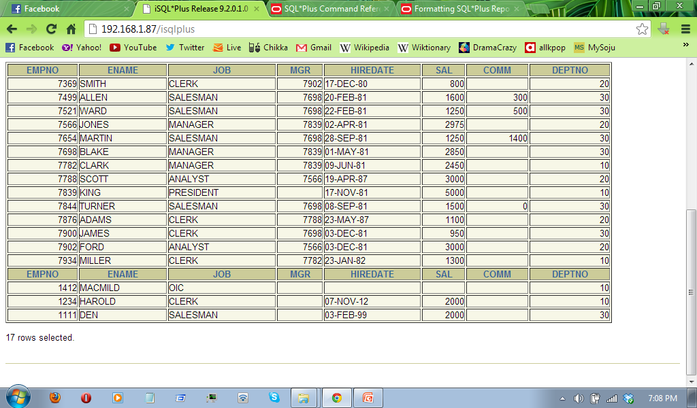
Inserting Specific Date Values
Add a new employee.
Verify your addition.
INSERT INTO maxim
VALUES (1111, 'DEN', 'SALESMAN', NULL,
TO_DATE('FEB 3, 1999', 'MON DD, YYYY'),
2000, NULL, 30);
1 row created.
Notes:
Inserting Specific Date and Time Values
The DD-MON-YY format is usually used to insert a date value. With this format, recall that the century defaults to the current century. Because the date also contains time information, the default time is midnight (00:00:00).
If a date must be entered in a format other than the default format, for example, with another century, or a specific time, you must use the TO_DATE function.
The example on the slide records information for employee Raphealy in the EMPLOYEES table. It sets the HIRE_DATE column to be February 3, 1999. If you use the following statement instead of the one shown on the slide, the year of the hire_date is interpreted as 2099.
INSERT INTO employees
VALUES (114,
'Den', 'Raphealy',
'DRAPHEAL', '515.127.4561',
'03-FEB-99',
'AC_ACCOUNT', 11000, NULL, 100, 30);
If the RR format is used, the system provides the correct century automatically, even if it is not the current one.
Instructor Note
The default date format in Oracle9i is DD-MON-RR. Prior to release 8.16, the default format was DD-MON-YY.

Slide 10
Creating a Script
Use & substitution in a SQL statement to prompt for values.
& is a placeholder for the variable value.
INSERT INTO maxim
VALUES (&empno, '&name', '&job', &mgr,
TO_DATE('&hiredate', 'MON DD, YYYY'),
&sal, &comm, &deptno);
Notes:
Creating a Script to Manipulate Data
You can save commands with substitution variables to a file and execute the commands in the file. The example above records information for a department in the DEPARTMENTS table.
Run the script file and you are prompted for input for the & substitution variables. The values you input are then substituted into the statement. This allows you to run the same script file over and over, but supply a different set of values each time you run it.
Instructor Note
Be sure to mention the following points about the script:
Do not prefix the iSQL*Plus substitution parameter with the ampersand in the DEFINE command.
Use a dash to continue an iSQL*Plus command on the next line.

Slide 11
Copying Rows from Another Table
Write your INSERT statement with a subquery.
Do not use the VALUES clause.
Match the number of columns in the INSERT clause to those in the subquery.
INSERT INTO newtable(id, name, salary, commission_pct)
SELECT empno, ename, sal, comm
FROM emp
WHERE job LIKE '%MAN%';
4 rows created.
Notes:
Copying Rows from Another Table
You can use the INSERT statement to add rows to a table where the values are derived from existing tables. In place of the VALUES clause, you use a subquery.
Syntax
INSERT INTO table [ column (, column) ] subquery;
In the syntax:
table is the table name
column is the name of the column in the table to populate
subquery is the subquery that returns rows into the table
The number of columns and their data types in the column list of the INSERT clause must match the number of values and their data types in the subquery. To create a copy of the rows of a table, use SELECT * in the subquery.
INSERT INTO copy_emp
SELECT *
FROM employees;
For more information, see Oracle9i SQL Reference, “SELECT,” subqueries section.
Instructor Note
Please run the script 8_cretabs.sql to create the COPY_EMP and SALES_REPS tables before demonstrating the code examples. Do not get into too many details on copying rows from another table.

Slide 12


Changing Data in a Table
EMPLOYEES
Update rows in the EMPLOYEES table.
Notes:
Changing Data in a Table
The slide graphic illustrates changing the department number for employees in department 60 to department 30.

Slide 13
The UPDATE Statement Syntax
Modify existing rows with the UPDATE statement.
Update more than one row at a time, if required.
UPDATE table
SET column = value [, column = value, ...]
[WHERE condition];
Notes:
Updating Rows
You can modify existing rows by using the UPDATE statement.
In the syntax:
table is the name of the table
column is the name of the column in the table to populate
value is the corresponding value or subquery for the column
condition identifies the rows to be updated and is composed of column names expressions, constants, subqueries, and comparison operators
Confirm the update operation by querying the table to display the updated rows.
For more information, see Oracle9i SQL Reference, “UPDATE.”
Note: In general, use the primary key to identify a single row. Using other columns can unexpectedly cause several rows to be updated. For example, identifying a single row in the EMPLOYEES table by name is dangerous, because more than one employee may have the same name.

Slide 14
Updating Rows in a Table
Specific row or rows are modified if you specify the WHERE clause.
All rows in the table are modified if you omit the WHERE clause.
UPDATE maxim
SET deptno = 40
WHERE empno = 1111;;
1 row updated.
UPDATE newtable
SET deptno = 50;
14 rows updated.
Notes:
Updating Rows (continued)
The UPDATE statement modifies specific rows if the WHERE clause is specified. The slide example transfers employee 113 (Popp) to department 70.
If you omit the WHERE clause, all the rows in the table are modified.
SELECT last_name, department_id
FROM copy_emp;
Note: The COPY_EMP table has the same data as the EMPLOYEES table.
…

Slide 15
Updating Two Columns with a Subquery
Update employee 1111’s job and salary to match that of
employee 7698.
UPDATE maxim
SET job = (SELECT job
FROM maxim
WHERE empno = 7698),
sal = (SELECT sal
FROM maxim
WHERE empno = 7698)
WHERE empno = 1111;
1 row updated.
Notes:
Updating Two Columns with a Subquery
You can update multiple columns in the SET clause of an UPDATE statement by writing multiple subqueries.
Syntax
UPDATE table
SET column =
(SELECT column
FROM table
WHERE condition)
[ ,
column =
(SELECT column
FROM table
WHERE condition)]
[WHERE condition ] ;
Note: If no rows are updated, a message “0 rows updated.” is returned.

Slide 16
Updating Rows Based on Another Table
Use subqueries in UPDATE statements to update
rows in a table based on values from another table.
UPDATE maxim
SET job = (SELECT job
FROM emp
WHERE empno = 7369),
sal = (SELECT sal
FROM emp
WHERE empno = 7369)
WHERE empno = 1111;
1 row updated.
Notes:
Updating Rows Based on Another Table
You can use subqueries in UPDATE statements to update rows in a table. The example on the slide updates the COPY_EMP table based on the values from the EMPLOYEES table. It changes the department number of all employees with employee 200’s job ID to employee 100’s current department number.

Slide 17
Updating Rows:
Integrity Constraint Error
UPDATE emp
SET deptno = 55
WHERE deptno = 110;
UPDATE emp
*
ERROR at line 1:
ORA-02291: integrity constraint (HR.EMP_DEPT_FK) violated - parent key not found
Department number 55 does not exist
Notes:
Integrity Constraint Error
If you attempt to update a record with a value that is tied to an integrity constraint, an error is returned.
In the example on the slide, department number 55 does not exist in the parent table, DEPARTMENTS, and so you receive the parent key violation ORA-02291.
Note: Integrity constraints ensure that the data adheres to a predefined set of rules. A subsequent lesson covers integrity constraints in greater depth.
Instructor Note
Explain integrity constraints, and review the concepts of primary key and foreign key.

Slide 18
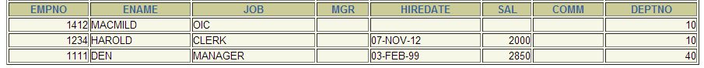
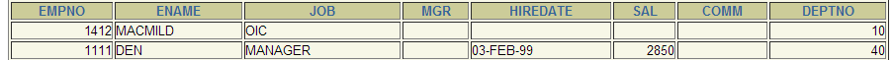
Removing a Row from a Table
EMPLOYEE
Delete a row from the EMPLOYEE table.
Notes:
Removing a Row from a Table
The slide graphic removes the Finance department from the DEPARTMENTS table (assuming that there are no constraints defined on the DEPARTMENTS table).
Instructor Note
After all the rows have been eliminated with the DELETE statement, only the data structure of the table remains. A more efficient method of emptying a table is with the TRUNCATE statement.
You can use the TRUNCATE statement to quickly remove all rows from a table or cluster. Removing rows with the TRUNCATE statement is faster than removing them with the DELETE statement for the following reasons:
The TRUNCATE statement is a data definition language (DDL) statement and generates no rollback information. It is covered in a subsequent lesson.
Truncating a table does not fire the delete triggers of the table.
If the table is the parent of a referential integrity constraint, you cannot truncate the table. Disable the constraint before issuing the TRUNCATE statement.

Slide 19
The DELETE Statement
You can remove existing rows from a table by using
the DELETE statement.
DELETE [FROM] table
[WHERE condition];
Notes:
Deleting Rows
You can remove existing rows by using the DELETE statement.
In the syntax:
table is the table name
condition identifies the rows to be deleted and is composed of column names, expressions, constants, subqueries, and comparison operators
Note: If no rows are deleted, a message “0 rows deleted.” is returned:
For more information, see Oracle9i SQL Reference, “DELETE.”
Instructor Note
The DELETE statement does not ask for confirmation. However, the delete operation is not made permanent until the data transaction is committed. Therefore, you can undo the operation with the ROLLBACK statement if you make a mistake.

Slide 20
Deleting Rows from a Table
Specific rows are deleted if you specify the WHERE clause.
All rows in the table are deleted if you omit the WHERE clause.
DELETE FROM maxim
WHERE empno = '1234';
1 row deleted.
DELETE FROM maxim;
16 rows deleted.
Notes:
Deleting Rows (continued)
You can delete specific rows by specifying the WHERE clause in the DELETE statement. The slide example deletes the Finance department from the DEPARTMENTS table. You can confirm the delete operation by displaying the deleted rows using the SELECT statement.
SELECT *
FROM departments
WHERE department_name = 'Finance';
no rows selected.
If you omit the WHERE clause, all rows in the table are deleted. The second example on the slide deletes all the rows from the COPY_EMP table, because no WHERE clause has been specified.
Example
Remove rows identified in the WHERE clause.
DELETE FROM employees
WHERE employee_id = 114;
1 row deleted.
DELETE FROM departments
WHERE department_id IN (30, 40);
2 rows deleted.

Slide 21
Deleting Rows Based on Another Table
Use subqueries in DELETE statements to remove
rows from a table based on values from another table.
DELETE FROM maxim
WHERE deptno =
(SELECT deptno
FROM dept
WHERE dname = 'OPERATIONS');
1 row deleted.
Notes:
Deleting Rows Based on Another Table
You can use subqueries to delete rows from a table based on values from another table. The example on the slide deletes all the employees who are in a department where the department name contains the string “Public.” The subquery searches the DEPARTMENTS table to find the department number based on the department name containing the string “Public.” The subquery then feeds the department number to the main query, which deletes rows of data from the EMPLOYEES table based on this department number.

Slide 22
Deleting Rows:
Integrity Constraint Error
DELETE FROM departments
WHERE department_id = 60;
DELETE FROM departments
*
ERROR at line 1:
ORA-02292: integrity constraint (HR.EMP_DEPT_FK) violated - child record found
You cannot delete a row that contains a primary key that is used as a foreign key in another table.
Notes:
Integrity Constraint Error
If you attempt to delete a record with a value that is tied to an integrity constraint, an error is returned.
The example on the slide tries to delete department number 60 from the DEPARTMENTS table, but it results in an error because department number is used as a foreign key in the EMPLOYEES table. If the parent record that you attempt to delete has child records, then you receive the child record found violation ORA-02292.
The following statement works because there are no employees in department 70:
DELETE FROM departments
WHERE department_id = 70;
1 row deleted.
Instructor Note
If referential integrity constraints are in use, you may receive an Oracle server error message when you attempt to delete a row. However, if the referential integrity constraint contains the ON DELETE CASCADE option, then the selected row and its children are deleted from their respective tables.

Slide 23
Using a Subquery in an INSERT Statement
INSERT INTO
(SELECT empno, ename,
hiredate, job, sal,
deptno
FROM maxim
WHERE deptno = 10)
VALUES (1234, ‘HAPPY’, SYSDATE, ‘CLERK’, 1000, 10);
1 row created.
Notes:
Using a Subquery in an INSERT Statement
You can use a subquery in place of the table name in the INTO clause of the INSERT statement.
The select list of this subquery must have the same number of columns as the column list of the VALUES clause. Any rules on the columns of the base table must be followed in order for the INSERT statement to work successfully. For example, you could not put in a duplicate employee ID, nor leave out a value for a mandatory not null column.

Slide 24
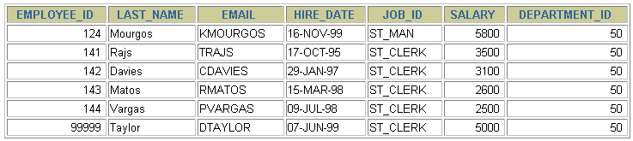
Using a Subquery in an INSERT Statement
Verify the results
SELECT employee_id, last_name, email, hire_date,
job_id, salary, department_id
FROM employees
WHERE department_id = 50;
Notes:
Using a Subquery in an INSERT Statement
The example shows the results of the subquery that was used to identify the table for the INSERT statement.

Slide 25
Using the WITH CHECK OPTION Keyword on DML Statements
A subquery is used to identify the table and columns of the DML statement.
The WITH CHECK OPTION keyword prohibits you from changing rows that are not in the subquery.
INSERT INTO (SELECT employee_id, last_name, email,
hire_date, job_id, salary
FROM employees
WHERE department_id = 50 WITH CHECK OPTION)
VALUES (99998, 'Smith', 'JSMITH',
TO_DATE('07-JUN-99', 'DD-MON-RR'),
'ST_CLERK', 5000);
INSERT INTO
*
ERROR at line 1:
ORA-01402: view WITH CHECK OPTION where-clause violation
Notes:
The WITH CHECK OPTION Keyword
Specify WITH CHECK OPTION to indicate that, if the subquery is used in place of a table in an INSERT, UPDATE, or DELETE statement, no changes that would produce rows that are not included in the subquery are permitted to that table.
In the example shown, the WITH CHECK OPTION keyword is used. The subquery identifies rows that are in department 50, but the department ID is not in the SELECT list, and a value is not provided for it in the VALUES list. Inserting this row would result in a department ID of null, which is not in the subquery.

Slide 26
Overview of the Explicit Default Feature
With the explicit default feature, you can use the DEFAULT keyword as a column value where the column default is desired.
The addition of this feature is for compliance with the SQL: 1999 Standard.
This allows the user to control where and when the default value should be applied to data.
Explicit defaults can be used in INSERT and UPDATE statements.
Notes:
Explicit Defaults
The DEFAULT keyword can be used in INSERT and UPDATE statements to identify a default column value. If no default value exists, a null value is used.

Slide 27
Using Explicit Default Values
DEFAULT with INSERT:
DEFAULT with UPDATE:
INSERT INTO dept
(deptno, dname, loc)
VALUES (50, ‘ENGINEERING', DEFAULT);
UPDATE dept
SET dname = DEFAULT WHERE deptno = 10;
Notes:
Using Explicit Default Values
Specify DEFAULT to set the column to the value previously specified as the default value for the column. If no default value for the corresponding column has been specified, Oracle sets the column to null.
In the first example shown, the INSERT statement uses a default value for the MANAGER_ID column. If there is no default value defined for the column, a null value is inserted instead.
The second example uses the UPDATE statement to set the MANAGER_ID column to a default value for department 10. If no default value is defined for the column, it changes the value to null.
Note: When creating a table, you can specify a default value for a column. This is discussed in the “Creating and Managing Tables” lesson.

Slide 28
The MERGE Statement
Provides the ability to conditionally update or insert data into a database table
Performs an UPDATE if the row exists, and an INSERT if it is a new row:
  Avoids separate updates
  Increases performance and ease of use
  Is useful in data warehousing applications
Notes:
MERGE Statements
SQL has been extended to include the MERGE statement. Using this statement, you can update or insert a row conditionally into a table, thus avoiding multiple UPDATE statements. The decision whether to update or insert into the target table is based on a condition in the ON clause.
Since the MERGE command combines the INSERT and UPDATE commands, you need both INSERT and UPDATE privileges on the target table and the SELECT privilege on the source table.
The MERGE statement is deterministic. You cannot update the same row of the target table multiple times in the same MERGE statement.
An alternative approach is to use PL/SQL loops and multiple DML statements. The MERGE statement, however, is easy to use and more simply expressed as a single SQL statement.
The MERGE statement is suitable in a number of data warehousing applications. For example, in a data warehousing application, you may need to work with data coming from multiple sources, some of which may be duplicates. With the MERGE statement, you can conditionally add or modify rows.

Slide 29
The MERGE Statement Syntax
You can conditionally insert or update rows in a
table by using the MERGE statement.
MERGE INTO table_name table_alias
USING (table|view|sub_query) alias
ON (join condition)
WHEN MATCHED THEN
UPDATE SET
col1 = col_val1,
col2 = col2_val
WHEN NOT MATCHED THEN
INSERT (column_list)
VALUES (column_values);
Notes:
Merging Rows
You can update existing rows and insert new rows conditionally by using the MERGE statement.
In the syntax:
INTO clause specifies the target table you are updating or inserting into
USING clause identifies the source of the data to be updated or inserted; can be a table, view, or subquery
ON clause the condition upon which the MERGE operation either updates or inserts
WHEN MATCHED | instructs the server how to respond to the results of the join condition
WHEN NOT MATCHED
For more information, see Oracle9i SQL Reference, “MERGE.”

Slide 30
Database Transactions
A database transaction consists of one of the
following:
DML statements which constitute one consistent change to the data
One DDL statement
One DCL statement
Notes:
Database Transactions
The Oracle server ensures data consistency based on transactions. Transactions give you more flexibility and control when changing data, and they ensure data consistency in the event of user process failure or system failure.
Transactions consist of DML statements that make up one consistent change to the data. For example, a transfer of funds between two accounts should include the debit to one account and the credit to another account in the same amount. Both actions should either fail or succeed together; the credit should not be committed without the debit.
Transaction Types

Slide 31
Database Transactions
Begin when the first DML SQL statement is executed
End with one of the following events:
  A COMMIT or ROLLBACK statement is issued
  A DDL or DCL statement executes (automatic commit)
  The user exits iSQL*Plus
  The system crashes
Notes:
When Does a Transaction Start and End?
A transaction begins when the first DML statement is encountered and ends when one of the following occurs:
A COMMIT or ROLLBACK statement is issued
A DDL statement, such as CREATE, is issued
A DCL statement is issued
The user exits iSQL*Plus
A machine fails or the system crashes
After one transaction ends, the next executable SQL statement automatically starts the next transaction.
A DDL statement or a DCL statement is automatically committed and therefore implicitly ends a transaction.
Instructor Note
Please run the script 8_cretest.sql to create the test table and insert data into the table.

Slide 32
Advantages of COMMIT and ROLLBACK Statements
With COMMIT and ROLLBACK statements, you can:
Ensure data consistency
Preview data changes before making changes permanent
Group logically related operations

Slide 33
Controlling Transactions
Time
COMMIT
Transaction
DELETE
SAVEPOINT A
INSERT
UPDATE
SAVEPOINT B
INSERT
ROLLBACK
to SAVEPOINT B
ROLLBACK
to SAVEPOINT A
ROLLBACK
Notes:
Explicit Transaction Control Statements
You can control the logic of transactions by using the COMMIT, SAVEPOINT, and ROLLBACK statements.
Note: SAVEPOINT is not ANSI standard SQL.
Instructor Note
Savepoints are not schema objects and cannot be referenced in the data dictionary.

Slide 34
Rolling Back Changes to a Marker
Create a marker in a current transaction by using the SAVEPOINT statement.
Roll back to that marker by using the ROLLBACK TO SAVEPOINT statement.
UPDATE...
SAVEPOINT update_done;
Savepoint created.
INSERT...
ROLLBACK TO update_done;
Rollback complete.
Notes:
Rolling Back Changes to a Savepoint
You can create a marker in the current transaction by using the SAVEPOINT statement which divides the transaction into smaller sections. You can then discard pending changes up to that marker by using the ROLLBACK TO SAVEPOINT statement.
If you create a second savepoint with the same name as an earlier savepoint, the earlier savepoint is deleted.
Instructor Note
Savepoints are especially useful in PL/SQL and 3GL programs in which recent changes can be undone conditionally based on run-time conditions.

Slide 35
Implicit Transaction Processing
An automatic commit occurs under the following circumstances:
  DDL statement is issued
  DCL statement is issued
  Normal exit from iSQL*Plus, without explicitly issuing COMMIT or ROLLBACK statements
An automatic rollback occurs under an abnormal termination of iSQL*Plus or a system failure.
Notes:
Implicit Transaction Processing
Note: A third command is available in iSQL*Plus. The AUTOCOMMIT command can be toggled on or off. If set to on, each individual DML statement is committed as soon as it is executed. You cannot roll back the changes. If set to off, the COMMIT statement can still be issued explicitly. Also, the COMMIT statement is issued when a DDL statement is issued or when you exit from iSQL*Plus.
System Failures
When a transaction is interrupted by a system failure, the entire transaction is automatically rolled back. This prevents the error from causing unwanted changes to the data and returns the tables to their state at the time of the last commit. In this way, the Oracle server protects the integrity of the tables.
From iSQL*Plus, a normal exit from the session is accomplished by clicking the Exit button. With SQL*Plus, a normal exit is accomplished by typing the command EXIT at the prompt. Closing the window is interpreted as an abnormal exit.

Slide 36
State of the Data
Before COMMIT or ROLLBACK
The previous state of the data can be recovered.
The current user can review the results of the DML operations by using the SELECT statement.
Other users cannot view the results of the DML statements by the current user.
The affected rows are locked; other users cannot change the data within the affected rows.
Notes:
Committing Changes
Every data change made during the transaction is temporary until the transaction is committed.
State of the data before COMMIT or ROLLBACK statements are issued:
Data manipulation operations primarily affect the database buffer; therefore, the previous state of the data can be recovered.
The current user can review the results of the data manipulation operations by querying the tables.
Other users cannot view the results of the data manipulation operations made by the current user. The Oracle server institutes read consistency to ensure that each user sees data as it existed at the last commit.
The affected rows are locked; other users cannot change the data in the affected rows.
Instructor Note
With the Oracle server, data changes can actually be written to the database files before transactions are committed, but they are still only temporary.
If a number of users are making changes simultaneously to the same table, then each user sees only his or her changes until other users commit their changes.
By default, the Oracle server has row-level locking. It is possible to alter the default locking mechanism.

Slide 37
State of the Data after COMMIT
Data changes are made permanent in the database.
The previous state of the data is permanently lost.
All users can view the results.
Locks on the affected rows are released; those rows are available for other users to manipulate.
All savepoints are erased.
Notes:
Committing Changes (continued)
Make all pending changes permanent by using the COMMIT statement. Following a COMMIT statement:
Data changes are written to the database.
The previous state of the data is permanently lost.
All users can view the results of the transaction.
The locks on the affected rows are released; the rows are now available for other users to perform new data changes.
All savepoints are erased.

Slide 38
Committing Data
Make the changes.
Commit the changes.
DELETE FROM maxim
WHERE empno = 1234;
1 row deleted.
INSERT INTO dept
VALUES (50,’CORPORATE TAX', NULL);
1 row inserted.
COMMIT;
Commit complete.
Notes:
Committing Changes (continued)
The slide example deletes a row from the EMPLOYEES table and inserts a new row into the DEPARTMENTS table. It then makes the change permanent by issuing the COMMIT statement.
Example
Remove departments 290 and 300 in the DEPARTMENTS table, and update a row in the COPY_EMP table. Make the data change permanent.
DELETE FROM departments
WHERE department_id IN (290, 300);
2 rows deleted.
UPDATE copy_emp
SET department_id = 80
WHERE employee_id = 206;
1 row updated.
COMMIT;
Commit Complete.
Instructor Note
Use this example to explain how COMMIT ensures that two related operations occur together or not at all. In this case, COMMIT prevents empty departments from being created.

Slide 39
State of the Data After ROLLBACK
Discard all pending changes by using the ROLLBACK
statement:
Data changes are undone.
Previous state of the data is restored.
Locks on the affected rows are released.
DELETE FROM maxim;
22 rows deleted.
ROLLBACK;
Rollback complete.
Notes:
Rolling Back Changes
Discard all pending changes by using the ROLLBACK statement. Following a ROLLBACK statement:
Data changes are undone.
The previous state of the data is restored.
The locks on the affected rows are released.
Example
While attempting to remove a record from the TEST table, you can accidentally empty the table. You can correct the mistake, reissue the proper statement, and make the data change permanent.
DELETE FROM test;
25,000 rows deleted.
ROLLBACK;
Rollback complete.
DELETE FROM test
WHERE id = 100;
1 row deleted.
SELECT *
FROM test
WHERE id = 100;
No rows selected.
COMMIT;
Commit complete.

Slide 40
Statement-Level Rollback
If a single DML statement fails during execution, only that statement is rolled back.
The Oracle server implements an implicit savepoint.
All other changes are retained.
The user should terminate transactions explicitly by executing a COMMIT or ROLLBACK statement.
Notes:
Statement-Level Rollbacks
Part of a transaction can be discarded by an implicit rollback if a statement execution error is detected. If a single DML statement fails during execution of a transaction, its effect is undone by a statement-level rollback, but the changes made by the previous DML statements in the transaction are not discarded. They can be committed or rolled back explicitly by the user.
Oracle issues an implicit commit before and after any data definition language (DDL) statement. So, even if your DDL statement does not execute successfully, you cannot roll back the previous statement because the server issued a commit.
Terminate your transactions explicitly by executing a COMMIT or ROLLBACK statement.
Instructor Note
The Oracle server implements locks on data to provide data concurrency in the database. Those locks are released when certain events occur (such as a system failure) or when the transaction is completed. Implicit locks on the database are obtained when a DML statement is successfully executed. The Oracle Server locks data at the lowest level possible by default .
Manually acquire locks on the database tables by executing a LOCK TABLE statement or the SELECT statement with the FOR UPDATE clause.
Starting with Oracle9i, the DBA has the choice of managing undo segments or having Oracle automatically manage undo data in an undo tablespace.
Please read the Instructor Note on page 8-52.
For more information on locking, refer to Oracle9i Concepts, “Data Concurrency and Consistency.”

Slide 41
Read Consistency
Read consistency guarantees a consistent view of the data at all times.
Changes made by one user do not conflict with changes made by another user.
Read consistency ensures that on the same data:
  Readers do not wait for writers.
  Writers do not wait for readers.
Notes:
Read Consistency
Database users access the database in two ways:
Read operations (SELECT statement)
Write operations (INSERT, UPDATE, DELETE statements)
You need read consistency so that the following occur:
The database reader and writer are ensured a consistent view of the data.
Readers do not view data that is in the process of being changed.
Writers are ensured that the changes to the database are done in a consistent way.
Changes made by one writer do not disrupt or conflict with changes another writer is making.
The purpose of read consistency is to ensure that each user sees data as it existed at the last commit, before a DML operation started.
Instructor Note
Please read the Instructor note on page 8-53.

Slide 42
Implementation of Read Consistency
User A
UPDATE employees
SET salary = 7000
WHERE last_name = 'Goyal';
Data
blocks
Rollback
segments
changed
and unchanged data
SELECT *
FROM userA.employees;
Read
consistent
image
before change
“old” data
User B
Notes:
Implementation of Read Consistency
Read consistency is an automatic implementation. It keeps a partial copy of the database in undo segments.
When an insert, update, or delete operation is made to the database, the Oracle server takes a copy of the data before it is changed and writes it to a undo segment.
All readers, except the one who issued the change, still see the database as it existed before the changes started; they view the rollback segment’s “snapshot” of the data.
Before changes are committed to the database, only the user who is modifying the data sees the database with the alterations; everyone else sees the snapshot in the undo segment. This guarantees that readers of the data read consistent data that is not currently undergoing change.
When a DML statement is committed, the change made to the database becomes visible to anyone executing a SELECT statement. The space occupied by the old data in the undo segment file is freed for reuse.
If the transaction is rolled back, the changes are undone:
The original, older version, of the data in the undo segment is written back to the table.
All users see the database as it existed before the transaction began.
Instructor Note
When you commit a transaction, the Oracle server releases the rollback information but does not immediately destroy it. The information remains in the undo segment to create read-consistent views of pertinent data for queries that started before the transaction committed.
Starting with Oracle9i, the DBA has the choice of managing undo segments or having Oracle automatically manage undo data in an undo tablespace. This is discussed in the DBA courses.

Slide 43
Summary
In this lesson, you should have learned how to use DML
statements and control transactions.
Statement
INSERT
UPDATE
DELETE
MERGE
COMMIT
SAVEPOINT
ROLLBACK
Description
Adds a new row to the table
Modifies existing rows in the table
Removes existing rows from the table
Conditionally inserts or updates data in a table
Makes all pending changes permanent
Is used to rollback to the savepoint marker
Discards all pending data changes
Notes:
Summary
In this lesson, you should have learned how to manipulate data in the Oracle database by using the INSERT, UPDATE, and DELETE statements. Control data changes by using the COMMIT, SAVEPOINT, and ROLLBACK statements.
The Oracle server guarantees a consistent view of data at all times.
Locking can be implicit or explicit.

Slide 44
Practice 8 Overview
This practice covers the following topics:
Inserting rows into the tables
Updating and deleting rows in the table
Controlling transactions
Notes:
Practice 8 Overview
In this practice, you add rows to the MY_EMPLOYEE table, update and delete data from the table, and control your transactions.

